Slide 1
Quantum-safe Encryption
Credit to NIST and Legion of Bouncy Castle

Slide 2
Outlines
What’s Quantum computing?
Quantum computers vs Turing machines
The threat
Quantum safe encryption
NIST and CRYSTALS-Kyber algorithm
Legion of Bouncy Castle
Java implementation (NextGPU)

Slide 3
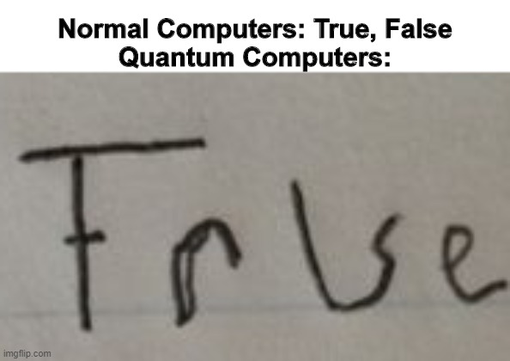
What is Quantum computing?
Quantum 101. Tiny particles that do weird things.
Quantum exists in multiple states 0 and 1 until observed.
In Quantum physics “I have no idea” is a valid answer.

Slide 4
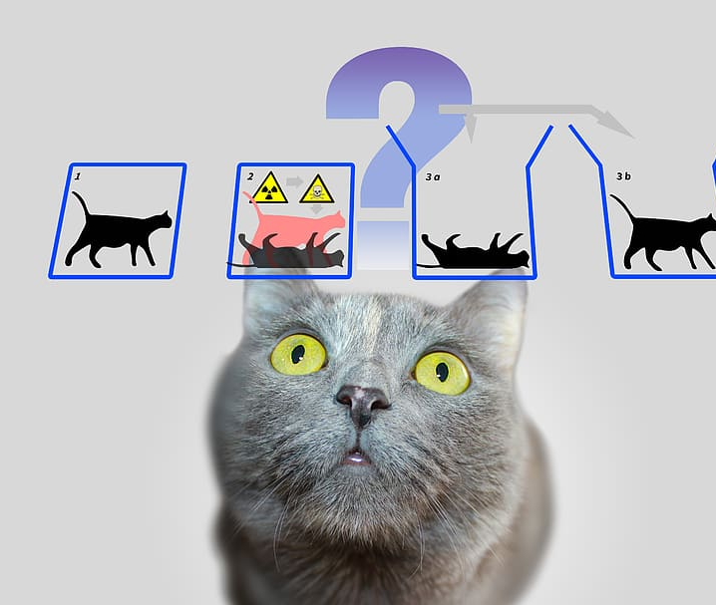
What is Quantum computing?
Schrödinger's cat experiment
In a box, there’s a cat; a flask of poison; a radioactive source
Is it alive, dying, dead, decayed?
All answers are valid till you observe
Quantum particles work similarly
Qubit is the simplest example Quantum particle
Superpositions

Slide 5
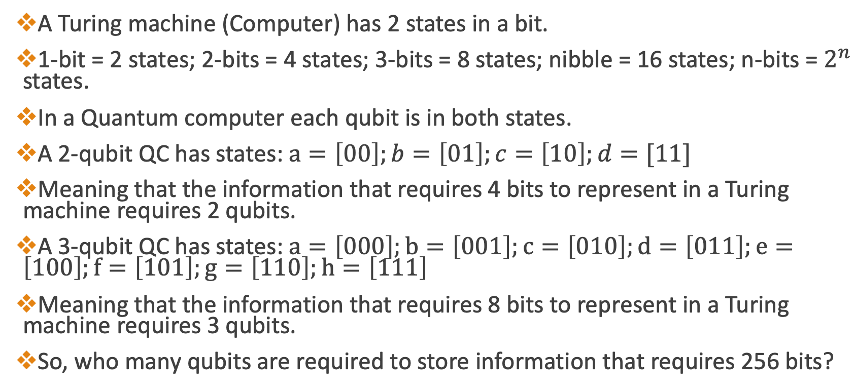
Quantum Computers vs Turing Machines
A Turing machine (Computer) has 2 states in a bit.
1-bit = 2 states; 2-bits = 4 states; 3-bits = 8 states; nibble = 16 states; n-bits = $2^{n}$ states.
In a Quantum computer each qubit is in both states.
A 2-qubit QC has states: $a=\left[00\right];b=\left[01\right];c=\left[10\right];d=[11]$
Meaning that the information that requires 4 bits to represent in a Turing machine requires 2 qubits.
A 3-qubit QC has states: $a=\left[000\right];b=\left[001\right];c=\left[010\right];d=\left[011\right];e=\left[100\right];f=\left[101\right];g=\left[110\right];h=\left[111\right]$
Meaning that the information that requires 8 bits to represent in a Turing machine requires 3 qubits.
So, who many qubits are required to store information that requires 256 bits?
Notes:
Quantum computers have exponential growth

Slide 6
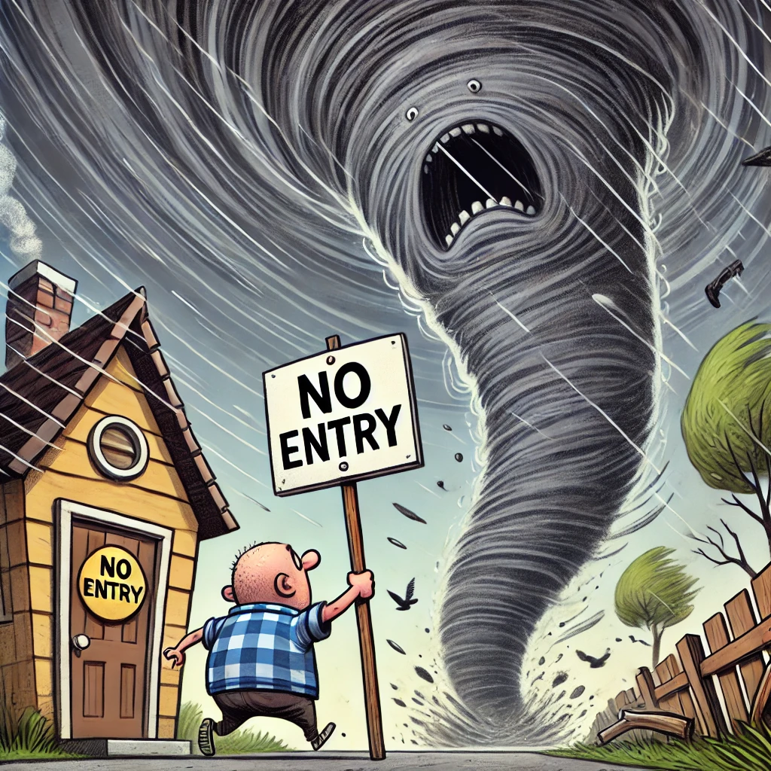
The Threat
Imagine a thief who can pick every lock in the world. That’s Quantum computer for encryption.
For a Quantum computer, cracking password “abcdef123456” is no different than “$tav3k(d!Qu4”.
Classical computers solve a maze by walking every path sequentially.
Quantum computers solve the same maze by walking all paths at once.
256-bit encryption is safe. For now. Hopefully.
So why worry today?
Notes:
Powerful nations are dumping encrypted data daily. One day, they will have built a QC strong enough to crack 256-bit encryption.

Slide 7
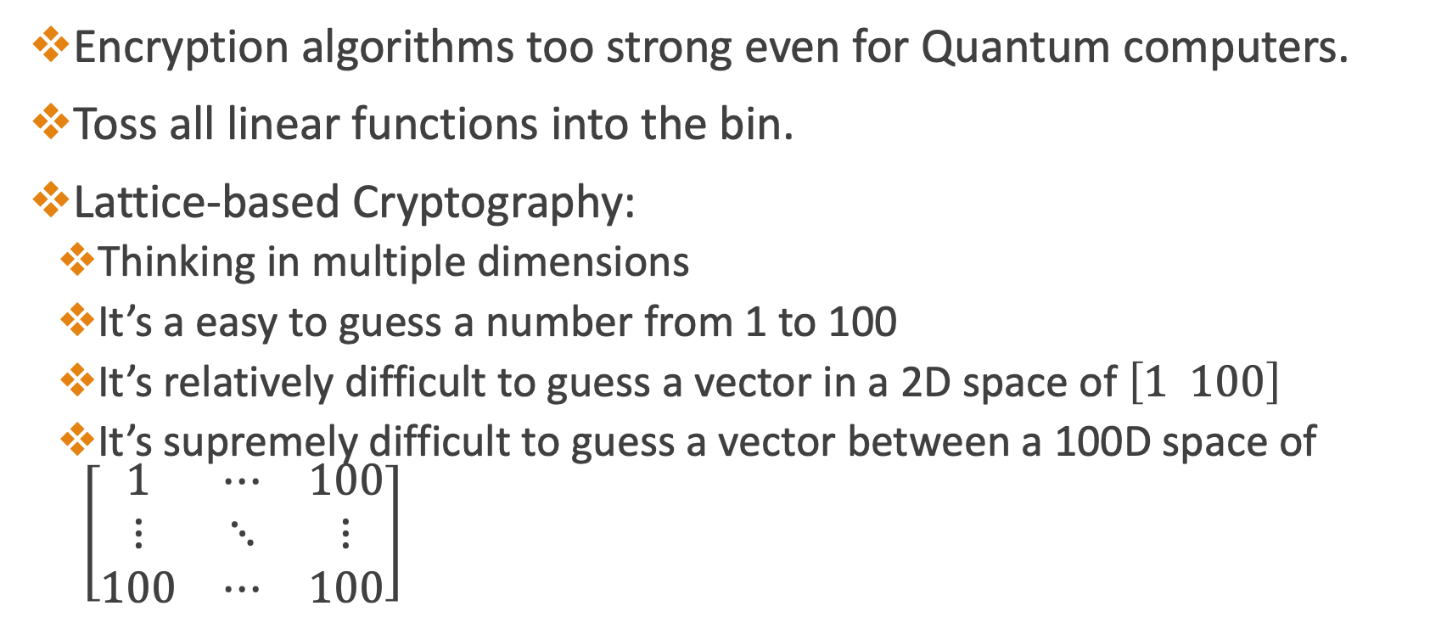
Quantum Safe Encryption
Encryption algorithms too strong even for Quantum computers.
Toss all linear functions into the bin.
Lattice-based Cryptography:
Thinking in multiple dimensions
It’s a easy to guess a number from 1 to 100
It’s relatively difficult to guess a vector in a 2D space of $\left[1 100\right]$
It’s supremely difficult to guess a vector between a 100D space of $\left[\begin{matrix}1 & ⋯ & 100 \\ ⋮ & ⋱ & ⋮ \\ 100 & ⋯ & 100\end{matrix}\right]$

Slide 8
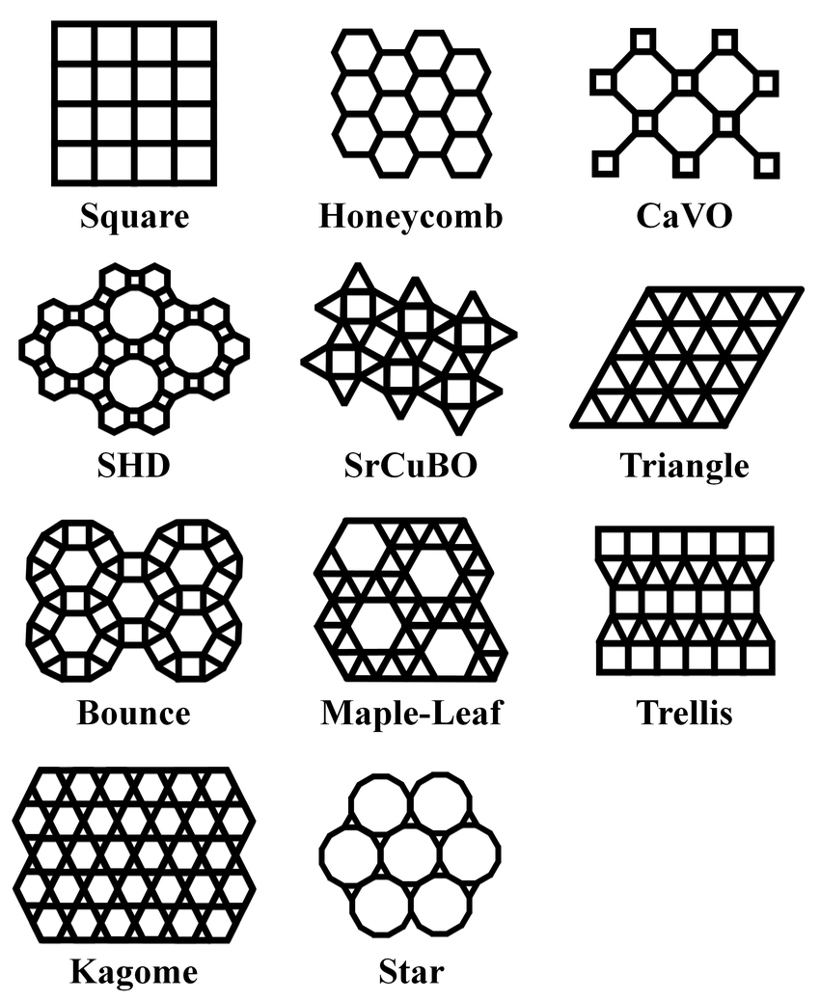
NIST and CRYSTALS-Kyber algorithm
National Institute of Standards and Technology.
NIST judged 70 algorithms. Only 4 survived.
CRYSTALS-Kyber is the Usain Bolt of those 4.
CRYSTALS-Kyber was announced in 2022. Finalized in August 2024.
Lattice based cryptography.
Canvas made of dots in a pattern

Slide 9
NIST and CRYSTALS-Kyber algorithm
The idea is like lock pattern on Android phones.
You start at origin, build a path by connecting vectors.
Lattice is the set of all points reachable by these vectors.
The attacker must solve the shortest vector problem to know the origin of lattice.
Using the public key (bad basis), it’s an extremely difficult problem to solve even for Quantum computers.
The receiver has a private key (good basis) which solves this problem relatively easily.

Slide 10
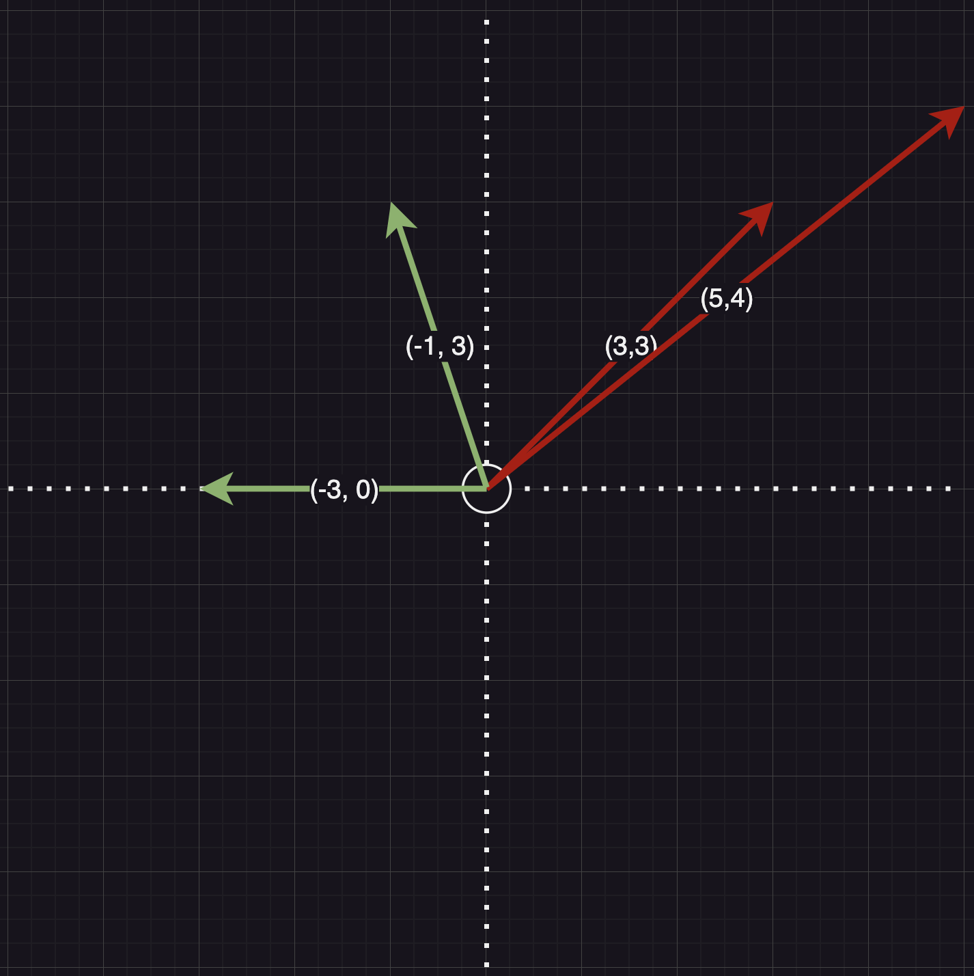
NIST and CRYSTALS-Kyber algorithm
Good basis (green): vectors that can reach origin quickly.
Bad basis (red): require extensive number of additions to come close to origin.
Now, reimagine solving the problem for 3 dimensions.
And then for 100 dimensions.

Slide 11
NIST and CRYSTALS-Kyber algorithm
Seems like a strong defense against Quantum attacks?!
Everything is not hunky dory.
A Quantum computer, coupled with Artificial intelligence is bad news.
AI can learn patterns to rule out from bad basis vectors.
Answer?
Kyber Encryption coupled with AES encryption.

Slide 12
NIST and CRYSTALS-Kyber algorithm
Let’s say Ayesha wants to say “Salam” to Faizan.
Faizan (receiver) will instantiate a 1024-bit Kyber keypair.
This keypair contains a public and a private key.
Faizan will send the public key to Ayesha, which will give a bad basis.
Ayesha will generate an AES encryption key using the public key.
Ayesha will then generate Sender’s Encapsulation Secret key from AES key and a random secret, encapsulated using Kyber Encapsulation Mechanism (KEM).
Ayesha now encrypts “Salam” using AES key and sends the Cypher to Faizan along with the encapsulation.

Slide 13
NIST and CRYSTALS-Kyber algorithm
Faizan (receiver) has cypher, but not the AES key.
Faizan has the private key, which is a good basis to solve shortest vector problem.
He also has the KEM-based encapsulation sent by Ayesha (this is renewed with each message).
Faizan generates a decryption key using private key and encapsulation.
The cypher is decrypted using the decryption key to extract “Salam”.

Slide 14
NIST and CRYSTALS-Kyber algorithm
The encryption is not bidirectional
Ayesha will also generate a private-public keypair to receive messages back.
The sender’s key is called Ephemeral because it is renewed with each incoming message.
This ensures that even if one secret is compromised, the next message is encrypted with a different secret.

Slide 15
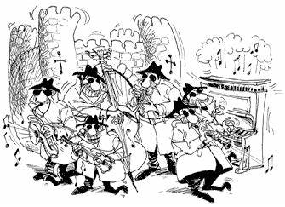
Legion of Bouncy Castle
Unsung heroes of the cryptography from Australia. Free, open-source
They turn abstract math (lattices, mazes, etc.) into usable code.
Without them, post-quantum migration would be like building a spaceship with a screwdriver.
Major components:
Lightweight API
JCE (Java Cryptography Extension)
Spongy Castle, an offshoot for Android world

Slide 16
Java Implementation (NextGPU)
CODE DEMO
Performance Testing

